Slide 1
Optics of a single Homogeneous and Isotropic Layer

Slide 2
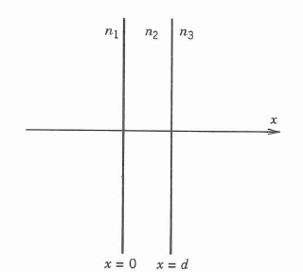
Electromagnetic Treatment
For the homogeneous and isotropic media, the whole structure can be described by

Slide 3
Electromagnetic Treatment
We assume that a plane wave is incident from the left, the electric field vector can be written as

Slide 4
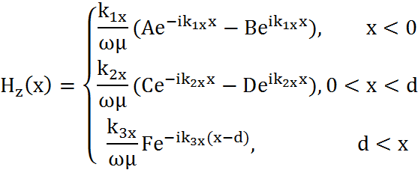
Electromagnetic Treatment
For s wave, the electric field E(x) is Ey, and Hz can be obtained by Maxwell equations.

Slide 5
Electromagnetic Treatment
Imposing the continuity of Ex and Hy at the interface x=0 and x=d leads to

Slide 6
Electromagnetic Treatment
The Fresnel reflection and transmission coefficients of the dielectric interfaces for s waves as

Slide 7
Electromagnetic Treatment
The transmission and reflection coefficients can be written as
where

Slide 8
Electromagnetic Treatment
A similar electromagnetic analysis for the p wave leads to exactly the same expressions for the transmission and reflection coefficients.

Slide 9
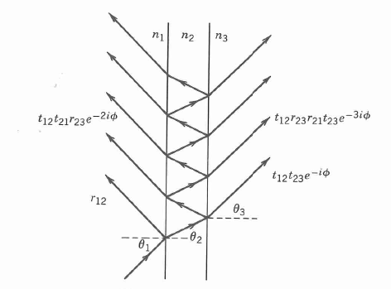
Airy’s Formulations
The transmission and reflection coefficients can also be derived by summing the amplitudes of successive reflection and refractions.

Slide 10
Airy’s Formulations

Slide 11
Airy’s Formulations

Slide 12
Airy’s Formulations
Substituting φ+π for φ in above expressions, we obtain

Slide 13
Airy’s Formulations
In the limit when the thickness of the layer becomes zero, the reflection and transmission coefficients should become those of the interface between media 1 and 3.

Slide 14
Airy’s Formulations
The presence of a half-wave layer with φ=π does not affect the reflection and transmission of light except for a possible change of sign.

Slide 15
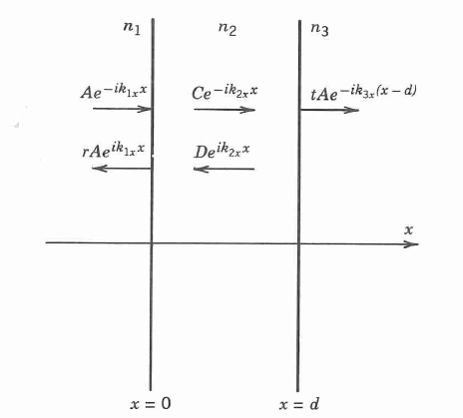
An Alternative Derivation
At the interface x=0, these are two incoming waves and two outgoing waves. The amplitudes of these waves are related by

Slide 16
An Alternative Derivation
At the interface x=d, these is only one incoming wave and two outgoing waves. The amplitudes of these waves are related by

Slide 17
An Alternative Derivation
By eliminating A, C, and D, we obtain

Slide 18
Transmittance, Reflectance, and Absorptance
Reflectance is defined as the fraction of energy reflected from the dielectric structure and is given by
Reflectance is meaningful only when medium 1 is nonabsorbing.
If medium 3 is also nonabsorbing, the transmittance is given by
The factor corrects for the difference in phase velocity.

Slide 19
Transmittance, Reflectance, and Absorptance
Absorptance, which is defined as the fraction of energy dissipated, is given by
A = 1 - R - T

Slide 20
A Thin Film on a Substrate

