Slide 1
Matrix Formulation for Isotropic Layered Media

Slide 2
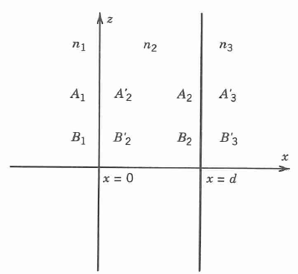
2Χ2 Matrix Formulation For a Thin Film
The dielectric structure is described by
The electric field can be
written as

Slide 3
2Χ2 Matrix Formulation For a Thin Film
The electric field E(x) consists of a right-traveling wave and a left-traveling wave and can be written as
Let A(x) represent the amplitude
of the right-traveling wave and
B(x) be that of the left-traveling
one.

Slide 4
2Χ2 Matrix Formulation For a Thin Film
To illustrate the matrix method, we define

Slide 5
2Χ2 Matrix Formulation For a Thin Film
If we represent the two amplitudes of E(x) as column vectors, the column vectors are related by

Slide 6
2Χ2 Matrix Formulation For a Thin Film
D1, D2 and D3 are the dynamical matrices and given by
Where α = 1,2,3

Slide 7
2Χ2 Matrix Formulation For a Thin Film
The matrices D12 and D23 may be regards as transmission matrices that link the amplitude of the waves on the two sides of the interface and are given by

Slide 8
2Χ2 Matrix Formulation For a Thin Film
The expression for D23 are similar to those of D12.
The equations can be written formally as

Slide 9
2Χ2 Matrix Formulation For a Thin Film
The amplitudes are related by

Slide 10
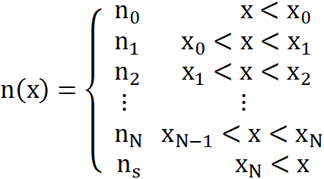
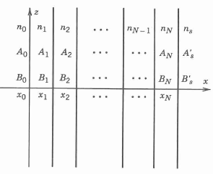
2Χ2 Matrix Formulation for Multilayer System
The multilayer structure can be described by

Slide 11
2Χ2 Matrix Formulation for Multilayer System
The electric field distribution E(x) can be written as

Slide 12
2Χ2 Matrix Formulation for Multilayer System
Using the same argument as in Section 5.1.1, we can write

Slide 13
2Χ2 Matrix Formulation for Multilayer System
The matrices can be written as

Slide 14
2Χ2 Matrix Formulation for Multilayer System
The relation between can be written as
with the matrix given by

Slide 15
Transmittance and Reflectance
If the light is incident from medium 0, the reflection and transmission coefficients are defined as

Slide 16
Transmittance and Reflectance
Using the matrix equation and following definitions, we obtain
The reflectance and transmittance are

Slide 17
Example: Quarter-Wave Stack
We consider a layered medium consisting of N pairs of alternating quarter-waves
with refractive indices n1 and n2, respectly.
Let n0 by the index of refraction of the incident medium and ns be the index of refraction of the substrate.

Slide 18
Example: Quarter-Wave Stack
The reflectance R at normal incidence can be obtained as follows: The matrix is given by
The propagation matrix for quarter-wave layers(with φ=(1/2)π) is given by

Slide 19
Example: Quarter-Wave Stack
By using Eq.(5.1-23) for the dynamical matrices and assuming normal incidence, we obtain, after some matrix manipulation,

Slide 20
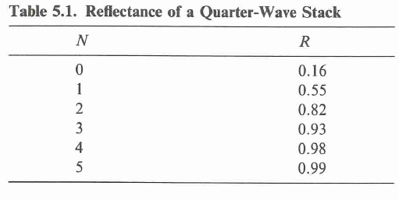
Example: Quarter-Wave Stack
Carrying out the matrix multiplication in Eq.(5.2-7) and using Eq. (5.2-5), the reflectance is
Reflectance of a Quarter-Wave Stack
Notes:
下一个例子书上没有什么公式推导，荣老师可以在黑板上推一下

Slide 21
General Theorems of Layered Media
The matrix elements Mij satisfy the relations
provides n1, n2, n3,and θ1, θ2 are real.
The propagation matrix Pl is a unimodular matrix

Slide 22
General Theorems of Layered Media
The matrix product is merely a transformation of the propagation matrix and is also unimodular. Thus, the determinant of the matrix M is very simple and given by

Slide 23
Left and Right Incidence Theorem
For a given dielectric structure defined by Eq.(5.1-16), the reflection and transmission coefficients defined by Eqs.(5.2-1) and (5.2-2), respectively, may be considered as function of β:

Slide 24
Left and Right Incidence Theorem
Let r’ and t’ be the reflection and transmission coefficients, respectively, when light is incident from the right side with the
same β.

Slide 25
Left and Right Incidence Theorem
Let T and T’ be the transmittances of the layered structure when light is incident from the left medium and right medium. These two transmittances are given by
Using Eq.(5.3-8) and the expression for |M| in Eq.(5.3-3), we obtain

Slide 26
Principles of Reversibility
For the case of a dielectric multilayer structure with real index of refraction, the functional relations between these four coefficients (r, t, r’, t’) can be obtained

Slide 27
Conservation of Energy
In the case when all the layers and the bounding media are pure dielectrics with real n, the conservation of energy requires that
R+T=1

