Slide 1
Reflection and Refraction of Plane Waves

Slide 2
Snell Law and Fresnel’s Formulas
The field amplitude of an incident plane wave with frequency ω and wave propagation Ki can be represented as
The corresponding reflected wave and transmitted wave can be represented as

Slide 3
Snell Law and Fresnel’s Formulas
Any boundary condition that relates these three field amplitudes at the plane interface x=0 will require that the spatial (and temporal) variation of all fields be the same. Consequently, the arguments of these field amplitudes at any point on the boundary x = 0 must satisfy the equation

Slide 4
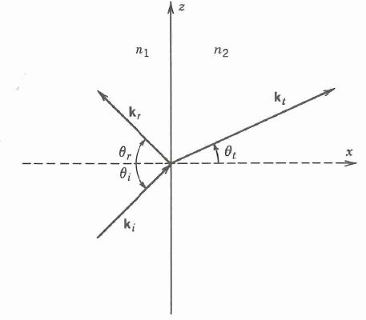
Snell Law and Fresnel’s Formulas

Slide 5
Snell Law and Fresnel’s Formulas
Let n1 and n2 be the indices of refraction of medium 1 and 2, respectively. The wave numbers have the magnitudes
All three wave propagation vectors ki, kr and kt must lie in a plane

Slide 6
Snell Law and Fresnel’s Formulas
Furthermore the tangential components of all three wave vectors must be the same. We can get the following relation:
Snell’s Law is

Slide 7
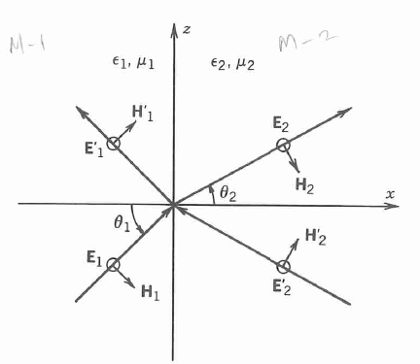
Reflection and Transmission of s Wave (TE Wave)
The s wave is also known as a TE wave because the electric field vector E is transverse to the plane of incidence.

Slide 8
Reflection and Transmission of s Wave (TE Wave)
Imposing the continuity of Ey and Hz at the interface x = 0 leads to

Slide 9
Reflection and Transmission of s Wave (TE Wave)
These two equations can be rewritten as a matrix equation
where

Slide 10
Reflection and Transmission of s Wave (TE Wave)
If the light is incident from medium 1, the reflection and transmission coefficients are given for a single interface as

Slide 11
Reflection and Transmission of s Wave (TE Wave)
Finally, we can obtain the equations

Slide 12
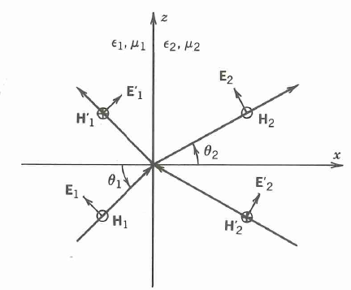
Reflection and Transmission of p Wave (TM Wave)
The p wave is also known as TM wave because the magnetic field vector is perpendicular to the plane of incidence.

Slide 13
Reflection and Transmission of p Wave (TM Wave)
Imposing the continuity of Ez and Hy at the interface x = 0 leads to

Slide 14
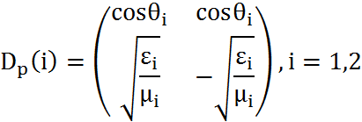
Reflection and Transmission of p Wave (TM Wave)
These two equations can be written as
Where

Slide 15
Reflection and Transmission of p Wave (TM Wave)
If the light is incident from medium 1, the reflection and transmission coefficients are given for a single interface as

Slide 16
Reflection and Transmission of p Wave (TM Wave)
Finally, we can obtain the equations

Slide 17
Reflectance and Transmittance
The Fresnel formulas give the ratios of the amplitude of the reflected wave and the transmitted wave to the amplitude of the incident wave.
The power flow parallel to the boundary surface is unaffected and is a constant throughout the medium.
As far as the reflection and transmission are concerned, we only consider the normal component of the time-averaged Poynting’s vector of the incident, reflected, and the transmitted waves.

Slide 18
Reflectance and Transmittance
The reflectance and transmittance are defined as

Slide 19
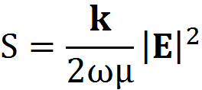
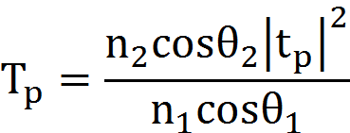
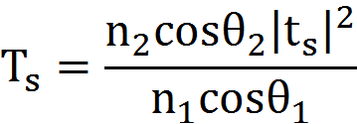
Reflectance and Transmittance
The time-average Poynting’s vector for a plane wave with a real wave vector is
The reflectance and transmittance are related to the Fresnel coefficients by the equations

Slide 20
Reflectance and Transmittance
The transmittance formulas are only valid for pure dielectric media.
The Reflectance and Transmittance are in agreement with the law of conservation of energy, that is R + T = 1.
Notes:
下一节垂直入射没有什么特别要讲的，上课时可在黑板上点一下

Slide 21
Principle of Reversibility
The coefficients of the light which is incident from medium 1 onto medium 2 can be note as r12 and t12.
The coefficients of the light which is incident from medium 2 onto medium 1 can be note as r21 and t21.
We can get the relationship

Slide 22
Principle of Reversibility
Furthermore, it can be sure that

Slide 23
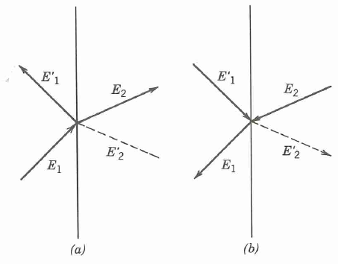
Principle of Reversibility

Slide 24
Principle of Reversibility
Referring to the figure, we can get
If we assume that the law of reflection and transmission holds for the time-averaged waves, we expect that the reverse-propagating and must produce their own reflected waves and transmitted waves.

Slide 25
Principle of Reversibility
Fresnel reflectance and transmittance for incidence 1→2 are equal to those of incidence 2→1 provide that these two media are dielectrics with real n1 and n2 and the incidence angles obey Snell refraction law.

Slide 26
Total Internal Reflection
If the incident medium has a refractive index larger than that of the second medium and if the incidence angle θ is sufficiently large, Snell’s law,

Slide 27
Total Internal Reflection
The critical angle of incidence, where sinθ2 = 1, is given by
For waves incident from medium 1 at θ1=θc, the refracted wave is propagating parallel to the interface. There can be no energy flow across the interface.

Slide 28
Total Internal Reflection
For incident angle θ1 > θc, sinθ2 > 1, this means that θ2 is a complex angle with a purely imaginary cosine

Slide 29
Total Internal Reflection
The Fresnel formulas for the reflection coefficients become
These two reflection coefficients are complex numbers of unit modulus, which means all the light energies are totally reflected from the surface.

Slide 30
Evanescent Waves
When the incident angle is greater than the critical angle θc, a wave will be totally reflected from the surface.
If we examine the Fresnel transmission coefficients ts and tp at total reflection, we notice that ts and tp are not vanishing.
This means that even though the light energies are totally reflected, the electromagnetic fields still penetrate into the second medium.

Slide 31
Evanescent Waves
The electric field of the transmitted wave is proportional to the real part of the complex quantities
Eliminate the θ2, we can get
where

Slide 32
Evanescent Waves
We notice that θ1>θc, q is a positive number, and the electric field vector decreases exponentially as x increases.
The time-averaged normal component of Poynting’s vector in the second medium can be evaluated

Slide 33
Goos-Hanchen Shift
The parallel component Sx is
If an optical beam is incident at an angle greater than critical angle, light will penetrate into the second medium with a depth of penetration on the order of 1/q.

Slide 34
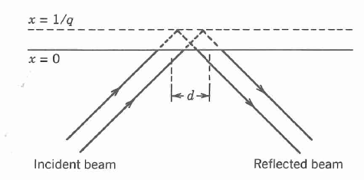
Goos-Hanchen Shift
A totally reflected optical beam of finite cross section will be displaced laterally relative to the incident beam at the boundary surface, which is known as Goos-Hanchen shift.
Notes:
我认为后面的公式推导意义不大， 可省略。

Slide 35
Polarization by Reflection; Brewster Angle
The reflectance of the s wave is always greater than the reflectance of the p wave except at normal incidence and grazing incidence.
Furthermore , the Fresnel reflection coefficient rp vanishes when the incidence angle is such that

Slide 36
Polarization by Reflection; Brewster Angle
Brewster angle equals
The Fresnel reflectance for the p wave vanishes when the propagation vectors of the transmitted wave and the reflected wave are mutually orthogonal.
Notes:
3.4节也就是折射率变复数，我觉得可以让学生们自学。

