Slide 1
The Electromagnetic Field

Slide 2
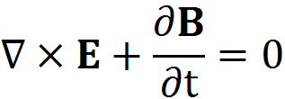
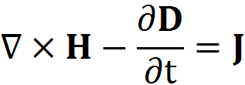
Maxwell Equations

Slide 3
Constitutive Equations

Slide 4
Boundary Conditions
Gauss divergence theorem
Leads to

Slide 5
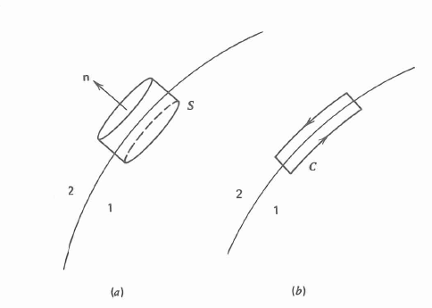
Boundary Conditions

Slide 6
Boundary Conditions
The normal component of the magnetic induction B is always continuous, and the difference between the normal components of the electric displacement D is equal in magnitude to the surface charge density σ.

Slide 7
Boundary Conditions
Stokes theorem
Leads to

Slide 8
Boundary Conditions
The tangential component of the electric field vector E is always continuous at the b oundary surface, and the difference between the tangential components of the magnetic field vector H is equal to the surface current density K

Slide 9
Energy Density and Energy Flux
The work done by the electromagnetic field can be written as
The right side can becomes

Slide 10
Energy Density and Energy Flux
The equation can be written as
Where U and S are defined as

Slide 11
Complex Numbers and Monochromatic Fields
For monochromatic light, the field vectors are sinusoidal functions of time, and it can be represented as a complex exponential functions

Slide 12
Complex Numbers and Monochromatic Fields
a(t) can be also written as
Note: Field vector have no imaginary parts, only real parts. The imaginary parts is just for mathematical simplification.

Slide 13
Complex Numbers and Monochromatic Fields
By using the complex formalism for the field vectors, the time-averaged Poynting’s vector and the energy density for sinusoidally varying fields are given by

Slide 14
Wave Equations and Monochromatic Plane Waves
The wave equation for the field vector E and the magnetic field vector H are as follows:
Notes:
方程的具体推导可在黑板上实现

Slide 15
Wave Equations and Monochromatic Plane Waves
Inside a homogeneous and isotropic medium, the gradient of the logarithm of ε and μ vanishes, and the wave equations reduce to
These are the standard electromagnetic wave equations.

Slide 16
Wave Equations and Monochromatic Plane Waves
The standard electromagnetic wave equations are satisfied by monochromatic plane wave
The wave vector k are related by

Slide 17
Wave Equations and Monochromatic Plane Waves
In each plane, k∙r =constant, the field is a sinusoidal function of time. At each given moment, the field is a sinusoidal function of space. It is clear that the field has the same value for coordinates r and times t, which satisfy
ωt-k∙r = const
The surfaces of constant phases are often referred as wavefronts.

Slide 18
Wave Equations and Monochromatic Plane Waves
The wave represented by
are called a plane wave because all the wavefronts are planar.
For plane waves, the velocity is represented by

Slide 19
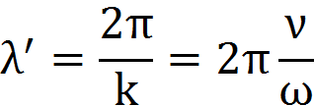
Wave Equations and Monochromatic Plane Waves
The wavelength is
The electromagnetic fields of the plane wave in the form
Where and are two constant unit vector

Slide 20
Wave Equations and Monochromatic Plane Waves
The Poynting’s vector can be written as
The time-averaged energy density is

Slide 21
Polarization States of Light
An electromagnetic wave is specified by its frequency and direction of propagation as well as by the direction of oscillation of the field vector.
The direction of oscillation of the field is usually specified by the electric field vector E.
Notes:
此节主要是公式推导，没有什么特别重要的结论公式。可在黑板上进行推导

